Slide 1


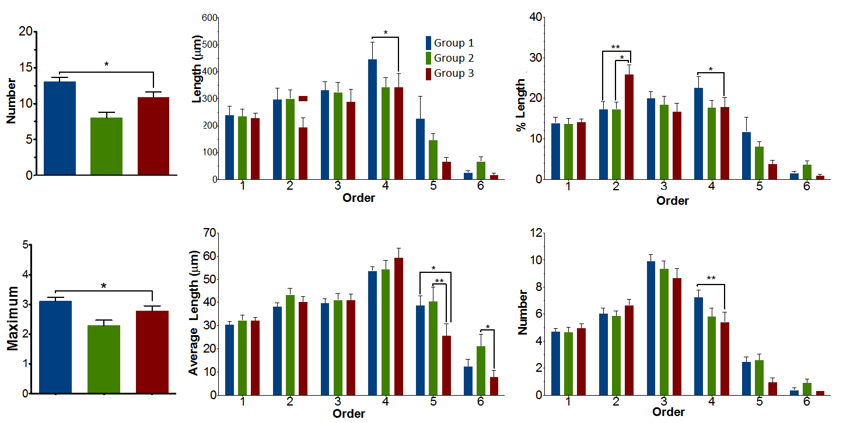
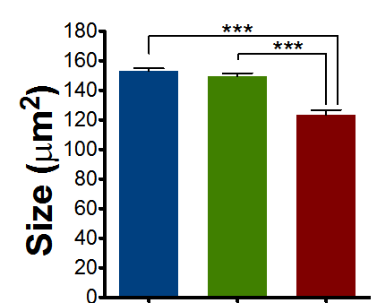
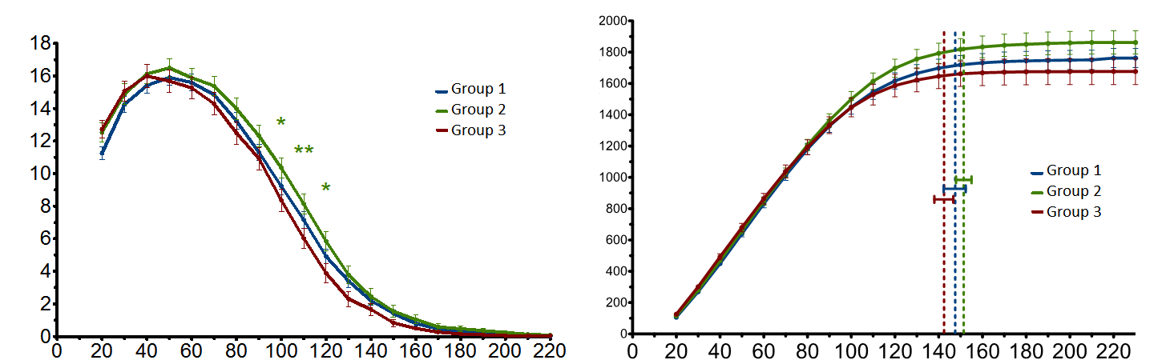
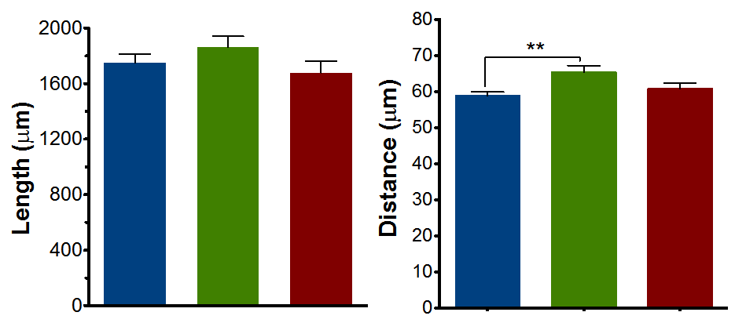
AI-Based Proactive Prediction Of GNSS Signal Degradation For Autonomous Vehicle Navigation
AI-Based Proactive Prediction Of GNSS Signal Degradation for Autonomous Vehicle Navigation
Ojerinde Joel Segun, Mustapha Ibrahim Ishola, Ogunlade Joshua Oluwaseun, Ingeriyinkindi Claudine, Rashid Md Harun Or
Regional Centre for Space Science and Technology Education in Asia and the Pacific | Beihang University
Introduction
System Architecture & Pipeline
Cross-city zero-shot: SENTINEL holds DEGRADED F1 = 0.75 on unseen Tokyo while Random Forest collapses to 0.15, a 5x generalisation gap.
GNSS is the only drift-free absolute position source for autonomous vehicles. At 60 km/h, a 5-second positioning gap can place the vehicle in the wrong lane or miss a junction.
In urban areas GNSS fails silently: NLOS multipath injects 10 to 200 m errors while the receiver still reports a 'valid' fix. Existing monitors (RAIM, Q-codes, ML classifiers) are reactive, acting only after degradation begins.
SENTINEL-GNSS instead predicts degradation 5 to 30 s in advance, giving the controller time to pre-activate dead reckoning.
A
B
C
SENTINEL-GNSS is a hybrid Transformer-LSTM. The Transformer (2 layers, 8 heads, d_model=128) reads global patterns across the 30 s window, while the stacked LSTM (hidden=256) tracks the directional approach to blockage as C/N0 declines and residuals grow. Three heads forecast +5 / +15 / +30 s in one forward pass.
Inference & Deployment: 1.46 M parameters, 0.039 ms per sample, all three horizons in one pass, 10.5x faster than three tree models, within a 10 Hz vehicle-compute budget.
D
E
F
Fig. 4: End-to-end SENTINEL-GNSS pipeline, from raw GNSS signals to multi-horizon AV-planner inputs via the Transformer-LSTM.
Materials and Methods
Multi-horizon classification (held-out test, n=1,686): strong +5 s performance that degrades gracefully with horizon.
A unified pipeline turns raw multi-city GNSS into 37 engineered features and multi-horizon degradation labels.
Horizon | Macro-F1 | DEGRADED-F1 | MCC
+5 s | 0.821 | 0.718 | 0.773
+15 s | 0.741 | 0.583 | 0.691
+30 s | 0.783 | 0.629 | 0.731
Fig. 7: Cross-city DEGRADED-class F1 at +5 s. SENTINEL 0.75 versus RF 0.15, a 5x generalisation gap that widens further at +15 s and +30 s.
Dataset: 149,662 labelled epochs across 4 cities and 9+ receiver types. Hangzhou (Beihang campus, Scenarios A to E, Septentrio Mosaic-X5C); Hong Kong (UrbanNav: Medium, Deep, Harsh, Tunnel); Tokyo held-out (Shinjuku Trimble, Shinjuku u-blox F9P, Odaiba).
Features: 37 features in 7 groups, position quality, signal strength, satellite geometry, pseudorange residuals, temporal patterns, atmospheric delays, and receiver status. The receiver_tier feature encodes hardware class so one model handles Septentrio (48 dB-Hz) and u-blox (38 dB-Hz) identically.
Model: a hybrid Transformer-LSTM. The Transformer (2 layers, 8 heads, d_model=128) reads global patterns across the 30 s window; a 2-layer LSTM (hidden=256) tracks the directional approach to blockage. Three heads predict +5, +15, and +30 s. 1.46 M parameters, 0.039 ms per sample.
Insert a Diagram or image to help explain your methods
Prediction-Informed EKF
Prediction inflates GPS noise R before bad epochs arrive (Joseph-form EKF):
Predict: xp = f(x, u); Pp = F P F^T + Q
Update: K = Pp H^T (H Pp H^T + R)^-1
x = xp + K (z - H xp)
P = (I - K H) Pp [Joseph form]
Adaptive: R = (40 m)^2 I2 if P(DEGRADED) > 0.45, else r_base^2 I2
Table 1: Multi-horizon classification metrics. Held-out test (n=1,686); 95% CI via 1,000 bootstrap iterations. DEGRADED recall = 0.847 at +5 s.
Classification performance across all horizons on the held-out test set.
Fig. 5: Macro-F1 and MCC across prediction horizons with bootstrap 95% CI. Performance degrades gracefully as the horizon extends.
Insert a Diagram or image to help explain your methods
Use a letter system to label separate panels
Use arrows to direct viewers to important details
Ablation: both the Transformer and the LSTM are necessary; receiver_tier is the most important feature.
Method | Environment | RMSE red.
EKF Fixed-R + SENTINEL | Trimble Shinjuku | 48.8%
Huber EKF | u-blox Shinjuku | 25.2%
Student-t PF | Odaiba harbour | 40.1%
A
B
A B C
Fig. 3: Row-normalised confusion matrices (+5 s, +15 s, +30 s). CLEAN recall stays above 0.97 at all horizons; DEGRADED recall falls from 0.85 to 0.73 as the horizon extends.
Conclusions
Dataset composition across four cities, with Tokyo strictly held out.
Fig. 6: Ablation across architecture variants (Macro-F1, MCC, DEGRADED-F1). Each component contributes independently to performance.
Key results: first system to predict GNSS degradation 5 to 30 s ahead; Macro-F1 = 0.821 at +5 s (DEGRADED recall 0.847); cross-city DEGRADED F1 of 0.75 vs 0.15 for RF; 48.8% degraded-RMSE reduction via prediction-informed EKF; 0.039 ms inference for all horizons.
Honest disclosure: RF and XGBoost beat SENTINEL in-domain (F1 0.926 vs 0.821), but cross-city generalisation is the deployment-relevant metric.
Key finding: no single fusion method dominates every environment, so environment-aware method selection is a productive direction.
Insert a Diagram or image to help explain your methods
Prediction-informed EKF keeps the trajectory accurate through blockage.
A
B
Insert an image to visualize what is being quantified in the graph to the left
*
Fig. 2: Dataset composition. Tokyo (49,868 epochs) is strictly held out and never seen during training or validation.
Reactive monitoring versus proactive prediction.
Acknowledgments
Fig. 1: Reactive monitoring gives 0 s warning. SENTINEL emits CLEAN, WARNING, and DEGRADED labels 30, 15, and 5 s before blockage, enabling pre-emptive fusion decisions.
We thank our supervisor Dr. Ahmed Wasiu and the H3I and RCSSTEAP programme at Beihang University for guidance, equipment, and field-collection support throughout the SENTINEL-GNSS pilot project.
Fig. 8: SENTINEL trajectory (blue) hugs ground truth through blockage while the Fixed-R EKF and raw GNSS diverge.
This work was funded by
Add the logo(s) from your funding organization

